Slide 1
Compilers: Principles ,Techniques, and tools
School of Computer Science and Technology , Shandong University

Slide 2
课 程 简 介
课程内容
  1 编译是计算机专业重要的专业课之一
  2 本课程介绍编译器构造的一般原理和基本实现方法,介绍的理论知识：形式语言和自动机理论、语法制导的定义和属性文法等
  3 强调形式化描述技术
  4 系统复杂,强调对编译原理和技术的总体理解，不把注意力分散到枝节算法，不偏向于某种源语言或目标机器

Slide 3
课 程 简 介
  5 发展迅速,成熟,并在进一步发展中(并行,RISC等)
  6 特点: 较深的理论基础和较强的实践性
  7目的: 了解掌握编译程序的构造方法,技术
  打好软件基本功
  8 安排: 上课,试验

Slide 4
教材和参考书
  A. Aho, R. Sethi, and J. D. Ullman, Compilers: Principles, Techniques, and Tools, 2nd edition, Addison-Wesley, 1986
  陈火旺等，程序设计语言编译原理 （第3版），国防工业出版社，2000
  陈意云，编译原理和技术（第二版），中国科大出版社，1997

Slide 5
The role of a compiler in a system
DBMS
OS Shell
OS Kernel
Kernel
A Compiler
Application Programs

Slide 6
Why to arrange the course of compilers？
1、 Seeing the development of a compiler gives you a feeling for how programs work. That can help you understand the internal process of program execution deeply

Slide 7
Why to arrange the course of compilers？
2、Many algorithms and models you will use in compilers are fundamental, and will be useful to you elsewhere:
  automata, regular expressions (lex’ing)
  context-free grammars, trees (parsing)
  hash tables (symbol table)
  dynamic programming, graph coloring(code gen.)

Slide 8
Why to arrange the course of compilers？
3、To program more efficient programs
Notes: Compiler writing spans programming languages, machine architecture, language theory, algorithms, and software engineering.
And the ideas behind principles and techniques of a compiler writing can be used many times in the career of a computer scientist.

Slide 9

Why to arrange the course of compilers？
4、

Slide 10
How to teach the course of compilers？
Syntax
Program
Language
Semantics
Language Usage
High Level
Human
Language
Translating
Compiling
Inverse compiling
Assembling
Machine
Machine
Translating：Oral Translating Compiling：Written Translating

Slide 11
How is a program to be processed and run ？
Lexical & Syntax Analysis
Source Code
Corrected Code
Syntax-directed Translation
Intermediated Code
Optimization
Target Code Generation
Assembling Code
Optimized Code
Assembler
Binary Code
Executable Code
OS
Linking
DLL

Slide 12
The objective of the course
To provide knowledge of paring techniques.
To provide knowledge of error detection and recovery using different parsing techniques.
To provide concepts in semantic and syntax analysis of a programming language.
To provide concepts in intermediate code generation and optimization.

Slide 13
Framework of The Course
1、Introduction to compiling
2、Programming Language and Grammar Definition
3、Lexical Analysis
Theoretical Model: Regular Grammar and Finite Automation
Implementation: Lexical Analysis Program
Tools : LEX
4、Syntax Analysis
Theoretical Model：Context-free Grammar and Push-down Automation, LL(1) Grammar,LR Grammar
Implementation: Recursive descent parsing
Operator-precedence parsing
LR parsing
Using ambiguous grammars
Tools: YACC

Slide 14
Framework of The Course
5、Intermediate Code Generation and Syntax-directed Translation
6、Type Checking and Run-Time Environment
7、Code Optimization: Block Optimization, Loop Optimization, Global Optimization
8、Target Code generation

Slide 15
How to learn the course?
1、Focus on understand the principles deeply
2、Notice the relations among the chapters
3、Do more exercises , more practices and combine the theory with the labs

Slide 16
Main References
√1、Compilers:Principles,Techniques,and Tools,A.V Aho,Ravi Sethi, J.D Ullman,人民邮电出版社，2002
2、陈意云，编译原理和技术（第二版），中国科大出版社，1997
3、程序设计语言编译原理，陈火旺，国防工业出版社,2000

Slide 17
How to evaluate?
1、Experiments – 20% (Total 4 experiments)
2、Term examination –80%

Slide 18
Chapter 1 Introduction to Compiling
Definitions:
翻译器、编译器、解释器
编译器从逻辑上可以分成若干阶段
每个阶段把源程序从一种表示变换成另一种表示
通过描述编译器的各个阶段来介绍编译这个课题

Slide 19
Definitions:
过程式语言 Fortran,Pascal,C
函数式语言 Lisp
逻辑式语言 Prolog
对象式语言 C++
汇编语言
机器语言
高级语言
低级语言：面向机器的语言
程序设
计语言

Slide 20
Definitions:
翻译：是指在计算机中放置一个能由计算机直接执行的翻译程序，它以某一种程序设计语言（源语言）所编写的程序（源程序）作为翻译或加工的对象，当计算机执行翻译程序时，就将它翻译为与之等价的另一种语言（目标语言）的程序（目标程序）。
输入
输出
编译：如果一个翻译程序的源语言是某种高级语言，其目标语言是相对于某一计算机的汇编语言或机器语言，则称这种翻译程序为编译程序（或称为编译器）。

Slide 21
编译和解释程序
初始数据
源
程
序
计
算
结
果
编
译
程
序
目标程序
解
释
程
序
计
算
结
果
源程序
初始数据

Slide 22
1.1 Compilers (P.1)
A compiler（编译器） is a program takes a program written in a source language and translates it into an equivalent program in a target language.

Slide 23
Chapter 1 Introduction to Compiling
1.1 Compilers
Source Program
Target Program
Compiler
Error Messages
Input
Output
Target Program

Slide 24
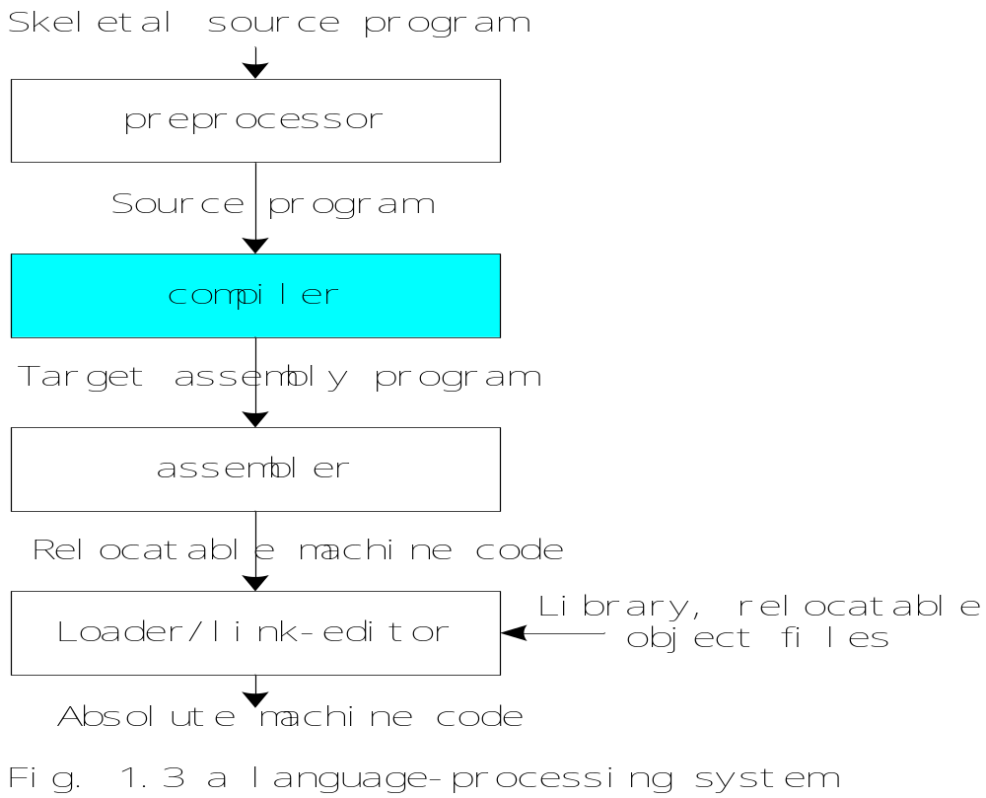
Compiling system (P.5)

Slide 25
1.4 cousins of the compiler (P.16)
Preprocessors
delete comments, include other files, perform macro substitutions.
compilers
A language translator. It executes the source program immediately. Depending on the language in use and the situation
Assemblers
A translator translates assembly language into object code
Linkers
Collects code separately compiled or assembled in different object files into a file.
Connects the code for standard library functions.
Connects resources supplied by the operating system of the computer.

Slide 26
Loaders
Relocatable : the code is not completely fixed .
Loaders resolve all relocatable address relative to the starting address.
Editors
Produce a standard file ( structure based editors)
Debuggers
Determine execution errors in a compiled program.

Slide 27
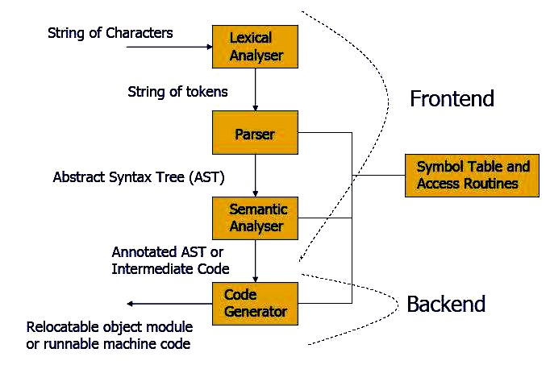
Chapter 1 Introduction to Compiling
1.2、Structure of a compiler

Slide 28
1.2 编译的阶段
源程序
词法分析器
语法分析器
语义分析器
符号表管理器
出错管理器
中间代码生成器
代码优化器
代码生成器
目标程序
Notes:
在此将前三个阶段概括为编译的分析部分，并介绍在一些工具中的应用。

Slide 29
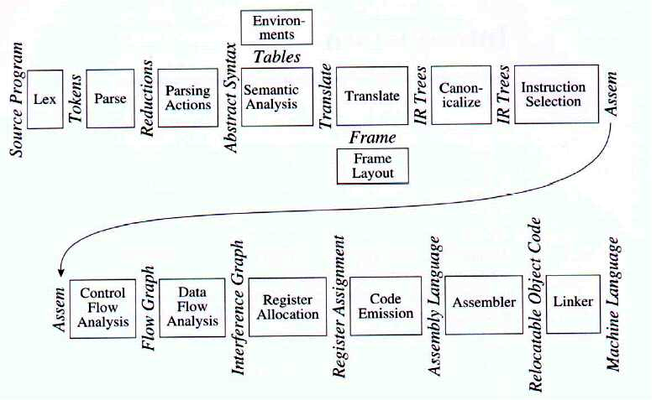
Chapter 1 Introduction to Compiling
More Structure of a compiler

Slide 30
Lexical Analyzer (P.5)
Lexical Analyzer（词法分析器） reads the source program character by character and returns the tokens of the source program.
A token （单词）describes a pattern of characters having some meaning in the source program. (such as identifiers, operators, keywords, numbers, delimeters and so on)

Slide 31
1.2.1 词法分析
词法分析逐个读构成源程序的字符，把它们组成词法记号（token）流。赋值语句（1.1）的字符流在词法分析时被组成下面的词法记号流
我们以Pascal的赋值语句
position := initial + rate * 60

Slide 32
（1）标识符（position）
（2）赋值号（:=）
（3）标识符（initial）
（4）加号（+）
（5）标识符（rate）
（6）乘号（*）
（7）数（60）

Slide 33
我们用id₁、id₂和id₃分别表示position、initial和rate，以强调标识符的内部表示是有别于形成标识符的字符序列的。于是，在词法分析后的表示是
id₁ := id₂ + id₃ * 60
编译器的词法分析也叫做线性分析或扫描

Slide 34
Lexical Analyzer (cont.)
Puts information about identifiers into the symbol table.
Regular expressions （正规/正则表达式）are used to describe tokens (lexical constructs).
A (Deterministic) Finite State Automaton （有限状态自动机）can be used in the implementation of a lexical analyzer.

Slide 35
Syntax Analyzer (P.6)
A Syntax Analyzer （语法分析器）creates the syntactic structure (generally a parse tree) of the given program.
A syntax analyzer is also called as a parser （语法分析器）.
A parse tree （语法树）describes a syntactic structure.
Ex: newval := oldval + 12
assgstmt
identifier := expression
newval expression + expression
identifier number
oldval 12
In a parse tree, all terminals （终结符）are at leaves.
All inner nodes are non-terminals in a context free grammar.
Fig.1.4 parse tree for newval := oldval + 12

Slide 36
1.2.2 语法分析
语法分析（syntax analysis）简称为分析（parsing），它把词法记号流按语言的语法结构层次地分组，以形成语法短语。因此语法分析也称为层次分析。源程序语法短语常用分析树表示

Slide 37
1.2.2 语法分析
position := initial + rate * 60
符 号 表
1
position
. . .
2
initial
. . .
词法分析器
3
rate
. . .
id₁ := id₂ + id₃ * 60

Slide 38
1.2.2 语法分析分析树
任何一个标识符都是表达式；
任何一个数都是表达式；
如果e₁和e₂都是表达式，那么
  • e₁ + e₂
  • e₁ * e₂
  • (e₁)
也都是表达式
表达式
表达式
表达式
+
表达式
表达式
标识符
*
(initial)
标识符
(rate)
数
(60)
Notes:
先介绍语法，然后才介绍语法分析。

Slide 39
1.2.2 语法分析
id₁ := id₂ + id₃ * 60
符 号 表
1
position
. . .
语法分析器
. . .
2
initial
3
rate
. . .
:=
id₁
+
id₂
*
id₃
60

Slide 40
1.2.2 语法分析
:=
id₁
+
id₂
*
符 号 表
id₃
60
. . .
1
position
语义分析器
2
initial
. . .
3
rate
. . .
:=
id₁
+
id₂
*
id₃
inttoreal
60

Slide 41
1.2.3 语义分析
语义分析阶段检查程序的语义正确性，以保证程序各部分能有意义地结合在一起，并为以后的代码生成阶段收集类型信息。
语义分析的一个重要部分是类型检查，编译器检查每个算符的运算对象，看它们的类型是否适当。

Slide 42
1.2.4 中间代码生成
语法分析和语义分析后，某些编译器产生源程序的显式中间表示，可以认为这种中间表示是一种抽象机的程序。中间表示必须具有两个性质：它易于产生并且易于翻译成目标程序。
中间表示有各种形式。在第七章，我们把中间表示看成三地址代码，它们像机器的汇编语言，这种机器的每个存储单元的作用类似于寄存器。三地址代码由三地址语句序列组成，每个三地址语句最多有三个操作数

Slide 43
Intermediate Code Generation (P.12)
A compiler may produce an explicit intermediate codes representing the source program.
These intermediate codes are generally machine (architecture) independent (except GCC). But the level of intermediate codes is close to the level of machine codes.

Slide 44
Intermediate Code Generation (example)
Ex:
  newval := oldval * fact + 1
  id1 := id2 * id3 + 1
  MULT temp1, id2, id3 ;Intermediates Codes (Quadraples or three address code)
  ADD temp2, temp1, #1
  MOV id1, temp2

Slide 45
1.2.5代码优化
代码优化阶段试图改进代码，以产生执行较快的机器代码。如果中间代码生成算法比较简单的话，它给代码优化留了很多机会。

Slide 46
Code Optimizer (for Intermediate Code Generator) (P.14)
The code optimizer optimizes the code produced by the intermediate code generator in the terms of time and space.
Ex:
  MULT temp1, id2, id3
  ADD temp2, temp1, #1
  MOV id1, temp2
  MULT temp1, id2, id3
  ADD id1, temp1, #1

Slide 47
1.2.6 代码生成
编译的最后一个阶段是目标代码生成，它生成可重定位的机器代码或汇编码。此阶段为源程序所用的每个变量选择存储单元，并且把中间代码翻译成等价的机器指令序列。此阶段的一个关键问题是寄存器分配

Slide 48
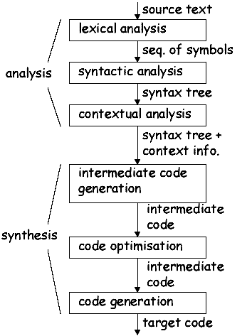
Chapter 1 Introduction to Compiling
The Analysis-Synthesis Model of Compilation
Linear analysis
Hierarchical analysis
Semantic analysis (type checking)

Slide 49
Chapter 1 Introduction to Compiling
1.2.7、Symbol-Table Management
  Record the identifiers used in the source program and collect information about various attributes of each identifier, such as its type, its scope
  A symbol table is a data structure containing a record for each identifier, with fields for the attributes of the identifier

Slide 50

Chapter 1 Introduction to Compiling
1.2.7、Symbol-Table Management
  Shared by later phases
  Allow to find the record for each identifier quickly and to store or retrieve data from the table quickly

Slide 51
Chapter 1 Introduction to Compiling
1.2.8、Error Detection and Reporting
  The syntax and semantic analysis phases usually handle a large fraction of the errors detectable by the compiler

Slide 52
1.3阶段的分组
前端后端
在实际的编译器中，若干阶段可以组合在一起，各阶段之间的中间表示也无需显式构造。
通常，所有的阶段被分成前端和后端两部分。前端只依赖于源语言，由几乎独立于目标机器的阶段或阶段的一部分组成。通常，它们是词法和语法分析、符号表建立、语义分析和中间代码生成，有些优化也可以在前端完成。前端还包括与这些阶段同时完成的错误处理。
后端是指编译器中依赖于目标机器的部分，它们一般独立于源语言，而与中间语言有关。后端包括代码优化、代码生成和伴随这些阶段的错误处理和符号表操作。

Slide 53
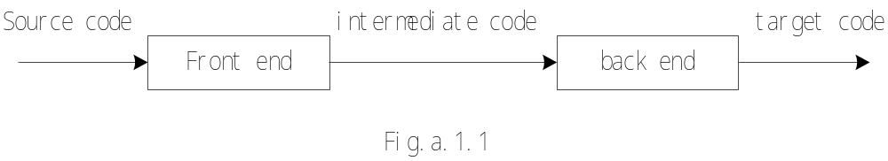
1.5 the grouping of phases (P.20)
analysis and synthesis
analysis: lexical analysis , syntax analysis, semantic analysis (optimization)
synthesis: code generation (optimization)
front end and back end
separation depend on the source language or the target language
the front end: the scanner（扫描器）, parser, semantic analyzer, intermediate code synthesis
the back end: the code generator, some optimization

Slide 54
1.3阶段的分组
遍
编译的几个阶段常用一遍（pass）扫描来实现，一遍扫描包括读一个输入文件和写一个输出文件。
减少变数
在工程实践中，有很多不同的方式把编译器的阶段组成遍，因此我们更愿意围绕着阶段而不是围绕遍来组织对编译的讨论。

Slide 55
1.5编译器伙伴
1.5.1预处理器
1.5.2宏汇编
1.5.3装配器和连接器

Slide 56
1.6编译器构造工具
分析器生成器
扫描器生成器
语法制导翻译工具
自动代码生成器
数据流分析工具

Slide 57
Chapter 1 Introduction to Compiling
、Compiler-Construction Tools
  Parser generators: Produce syntax analyzers, normally from input that is based on a context-free grammar
  Scanner generators: Automatically generate lexical analyzers, normally from a specification based on regular expression

Slide 58
Chapter 1 Introduction to Compiling
Compiler-Construction Tools
  Syntax-directed translation engine: Produce collections of routines that walk the parse tree, generating intermediate code
  Automatic code generators: Take a collection of rules that define the translation of each operation of the intermediate language into the machine language for the target machine

Slide 59
Chapter 1 Introduction to Compiling
Compiler-Construction Tools
  Data-flow engines

Slide 60
Chapter 1 Introduction to Compiling
9、How to construct a compiler?
  Program in a machine language for target machine directly
  Program in an assembling language
  Notes: The kernel of a compiler is usually programmed in an assembling language
  Program in high-level language
  Notes: This is an ordinary method

Slide 61
Chapter 1 Introduction to Compiling
9、How to construct a compiler?
  Self-Compiling
  Use compiler-construction tools
    Lex,Yacc
  Port among different platforms
  Notes: When constructing a compiler, a source language, a destination language and the compiling methods should be considered

